Slide 1
[Standardized framework for avatar data transfer using preset values across metaverse platforms ]
[3079.3.2.1 ]
[Jun young Kwak / UT Plus Interactive Inc. ]
[Hyun Duck Shin / HSU]
[Ki Taek Park / HSU]
[Dae ki Kang / DSU]
3079-24-0103-00-0003- avatar data transfer using preset values across metaverse platforms

Slide 2
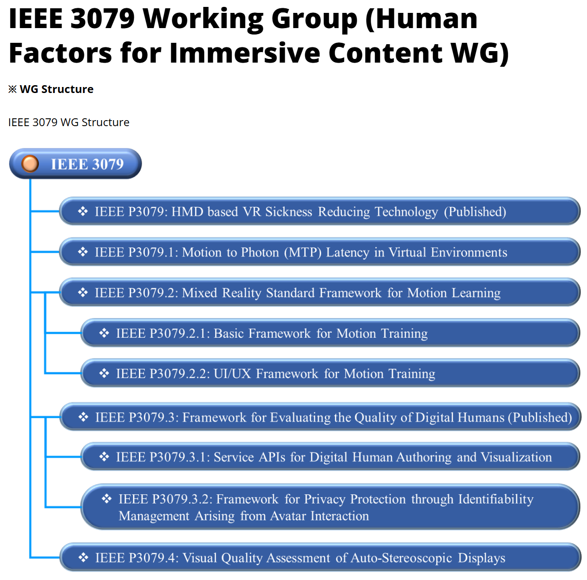
IEEE 3079 Human Factor for Immersive Content Working Group
-
3079-24-0103-00-0003- avatar data transfer using preset values across metaverse platforms

Slide 3
Scope of Avatar Data Transfer (using Preset Values)
Ensures Compatibility and consistency of user avatar visual data
Avatar visual customization, interacton data
Clarifying ownership of digital identity and content.
Transfering the User’s avatar data from the metaverse service to another metaverse service.
Provides interoperability and scalability between various XR metaverse platforms.
3079-24-0103-00-0003- avatar data transfer using preset values across metaverse platforms

Slide 4
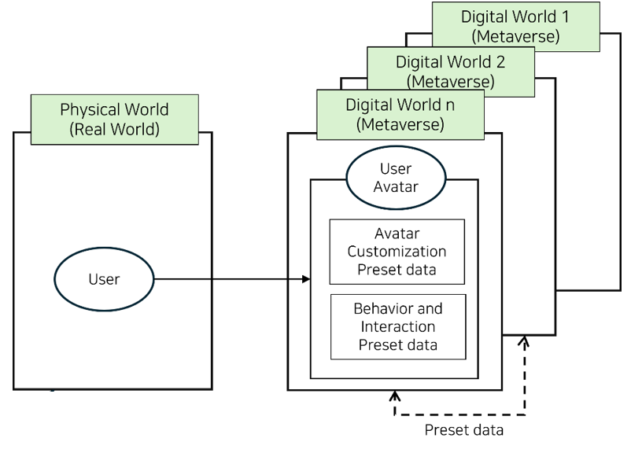
Scenario Architecture
3079-24-0103-00-0003- avatar data transfer using preset values across metaverse platforms

Slide 5
Standard preset codes for avatar appearance
Skin Tone: 001.000.000.001
Hair Style: 002.001.000.003
Eye Color: 003.002.000.002
Height: 004.180.000.000
Outfit: 005.001.001.002
Each section of the code can represent different aspects of the avatar’s appearance:
Each section of the code can represent different aspects of the avatar’s appearance:
· The first set of three digits (001, 002, 003, etc.) could denote different categories like skin tone, hair, eyes, etc.
· The second set of three digits could denote specific options within that category, like specific colors or styles.
· The subsequent sets of digits can be used to further refine the options or denote variations.
3079-24-0103-00-0003- avatar data transfer using preset values across metaverse platforms

Slide 6
Avatar data structure
Name | Field Name | Type | Description
Copyright information | ‘copyright`’ | string | Copyright notice for NFT content
 | `creator` | string | The creator or author of the NFT.
 | ‘license’ | string | Document URI address for the license under which the NFT is provided
Avatar Style Information | ‘height’ | number | Avatar's height
 | ‘bodyShape’ | string | Avatar body type description
 | ‘skinColor’ | string | Avatar skin color
 | ‘hairStyle’ | string | Avatar's Hairstyle
 | ‘clothingStyle’ | string | Avatar's clothing style preference
Meta Data ( VRM / glTF ) | ‘modelFormat’ | string | Specify model format ( VRM, glTF )
 | ‘modelVersion’ | string | version of the model
 | ‘animationType’ | string | Available animation types (e.g. rigging, facial expressions)
 | ‘accessories’ | array | List of accessories used with avatars
 | ‘fileHash’ | string | Hash value of model file, for verifying file integrity
3079-24-0103-00-0003- avatar data transfer using preset values across metaverse platforms

Slide 7
Functional Description
Authorization Service
(out of scope)
Metaverse server
ADAPI - 1
ADAPI - 4
Other Metaverse Service
(out of scope)
Avatar Data API Server
(preset code)
ADAPI - 5
ADAPI - 6
ADAPI - 2
ADAPI - 3
Avatar Data Service 1
Avatar Data Service N
Copyright info.
Etc. data
Copyright info.
Etc. data
Avatar Style Info.
Meta Data info.
Avatar Style Info.
Meta Data info.
Avatar Data Services (ADS)
3079-24-0103-00-0003- avatar data transfer using preset values across metaverse platforms

Slide 8
The needs for Avatar Data Transfer (using Preset Values)
The metaverse industry is growing rapidly.
It is essential to provide user-centric experiences, lower barriers between metaverse platforms, and increase user participation.
It is necessary to improve the continuity and convenience of user experiences across metaverse platforms, maintain consistency in managing users' digital identities, and promote the development of the metaverse ecosystem through interoperability.
In addition, this standard framework is expected to contribute to the sustainable growth and evolution of the metaverse ecosystem by facilitating interoperability between metaverse platforms.
3079-24-0103-00-0003- avatar data transfer using preset values across metaverse platforms

Slide 9
Avatar Data JSON representaion
{
"title": "NFT Metadata Standard for Metaverse Avatars",
"description": "Standard specification for including copyright, personal, and appearance
information in NFTs for Metaverse Avatars.",
"type": "object",
"properties": {
"copyright": {
"description": "Copyright notice for the NFT content.",
"type": "string"
},
"creator": {
"description": "The creator or author of the NFT.",
"type": "string"
},
"license": {
"description": "A URI to a document detailing the license under which the NFT is provided.",
"type": "string"
},
"personalInfo": {
"description": "Personal information related to the digital avatar.",
"type": "object",
"properties": {
"identity": {
"description": "A unique identifier for the avatar.",
"type": "string"
},
"ageGroup": {
"description": "The age group the avatar represents.",
"type": "string"
},
"preferences": {
"description": "Preferences of the avatar or user, such as favorite activities.",
"type": "array",
"items": {
"type": "string"
}
}
}
},
Avatar Data JSON representaion
3079-24-0103-00-0003- avatar data transfer using preset values across metaverse platforms

Slide 10
Avatar Data JSON representaion
"appearance": {
"description": "Appearance attributes defining the look of the avatar in VRM and glTF formats.",
"type": "object",
"properties": {
"height": {
"description": "Height of the avatar.",
"type": "number"
},
"bodyShape": {
"description": "Body shape description of the avatar.",
"type": "string"
},
"skinColor": {
"description": "Skin color of the avatar.",
"type": "string"
},
"hairStyle": {
"description": "Hair style of the avatar.",
"type": "string"
},
"clothingStyle": {
"description": "Clothing style preferences for the avatar.",
"type": "string"
},
"accessories": {
"description": "Accessories the avatar is wearing, such as glasses or jewelry.",
"type": "array",
"items": {
"type": "string"
}
}
}
},
"format": {
"description": "The file format of the avatar model, e.g., VRM, glTF.",
"type": "string"
}
},
"required": ["copyright", "creator", "license", "personalInfo", "appearance", "format"]
}
3079-24-0103-00-0003- avatar data transfer using preset values across metaverse platforms

Slide 11
Thank You

